Slide 1
Health Insurance and Vehicle Insurance Cross Sell Prediction
Group 5
Zijia Liu, Xiwei Shen, Fangzhou Yuan

Slide 2
Project Overview
id | Customer ID
Gender | Customer gender
Age | Customer age
Driving License | 0 : Customer does not have DL, 1 : Customer already has DL
Region Code | Unique code for the region of the customer
Previously Insured | 1 : Customer already has Vehicle Insurance, 0 : Customer doesn't have Vehicle Insurance
Vehicle Age | Age of the Vehicle
Vehicle Damage | 1 : Customer’s vehicle was damaged in the past. 0 : Customer’s vehicle was not damaged in the past.
Annual Premium | The amount customer needs to pay as premium in the year
Policy Sales Channel | Anonymized Code for the channel of outreaching to the customer ie. Different Agents, Over Mail, Over Phone, In Person, etc.
Vintage | Number of Days, Customer has been associated with the company
Response | 1 : Customer is interested, 0 : Customer is not interested
Health insurance company wants to expand their business to vehicle insurance.
381109 observations with 12 columns
Dataset: customers’ personal information + vehicle-related data

Slide 3
Project Goals
Predictions:
What kind of vehicle information will lead the customer to be interested in vehicle insurance?
What kind of health insurance information will lead the customer to be interested in vehicle insurance?
Inferences:
For customers of different gender or age groups (young / middle-aged / elder), is there any significant difference in their interest in vehicle insurance?
The median value of the “Vintage” variable in our dataset is 154 and the third quartile is 227. For customers who have been associated with the company longer than 227 days, are they more likely to be interested in the company’s vehicle insurance?
Which predictors in our dataset are the most important predictors for determining whether the customer is interested in vehicle insurance.

Slide 4
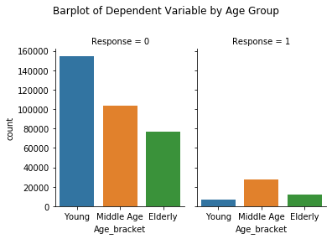
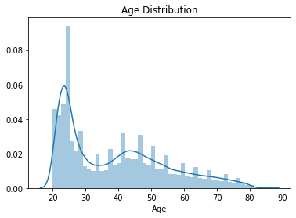
Data Exploration & Visualization
Clean Dataset (no NAs, Outliers)
Imbalanced dataset
For customers of different gender or age groups (young / middle-aged / elder), is there any significant difference in customer interest in vehicle insurance?

Slide 5
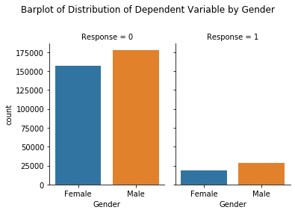
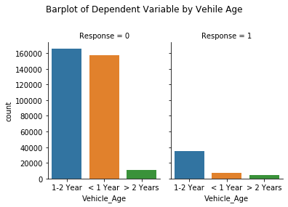
Visualizations (cont.)

Slide 6
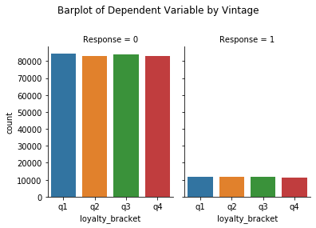
Visualizations (cont.)
The median value of the “Vintage” variable in our dataset is 154 and the third quartile is 227. For customers who have been associated with the company longer than 227 days, are they more likely to be interested in the company’s vehicle insurance?

Slide 7
Models Built
 | AUC Score
LR | 0.8196
DT | 0.8022
RF | 0.8363
GBM | 0.8519
Logistic Regression
Decision Tree
Support Vector Machine
Random Forest
Gradient Boosting Machine

Slide 8
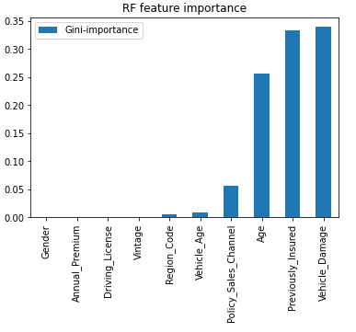
Prediction Results
 | Top 3 Important Features
LR | “Previously Insured”, “Vehicle Damage”, “Age”
RF | “Vehicle Damage”, “Previously Insured”, “Age”
GBM | “Vehicle Damage”, “Age”, “Previously Insured”

Slide 9
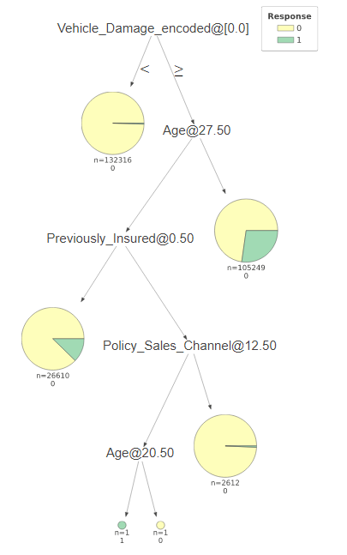
Problems Encountered
All of the nodes in our Decision Tree model have been labeled as 0, which means that the model is only reflecting what kind of information will not lead the customer to be interested in vehicle insurance. We will try to build a Decision Tree model with a larger maximum depth.

Slide 10
Summary and Additional Work
Summary
Models are accurate at predicting the Response = 0 label
Inferences questions are solved
Prediction questions are left to be answered more precisely
Future Work:
Apply undersampling/oversampling to overcome imbalanced data
Focus on recall
Apply grid search and CV to improve performance
Try XgBoost/Neural Networks

Slide 11
Q&A
Link to dataset: https://www.kaggle.com/anmolkumar/health-insurance-cross-sell-prediction
Contribution of team members: Zijia Liu: Project overview, Logistic Regression, Decision Tree
Xiwei Shen: SVM, Random Forest, Model Evaluation
Fangzhou Yuan: Data exploration, Visualizations, GBM

